Slide 1

HS 2015
Current Trends in Distributed Systems
Final presentation
Group:
Patrick Zumsteg
Simon Wallny
Philipp Oldenburg

Slide 2
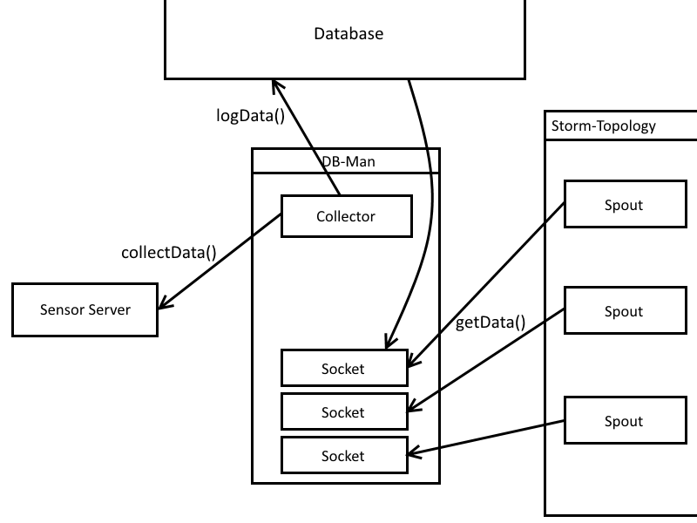
DBMan – Before
HS 2015
Current Trends in Distributed Systems – Final presentation

Slide 3
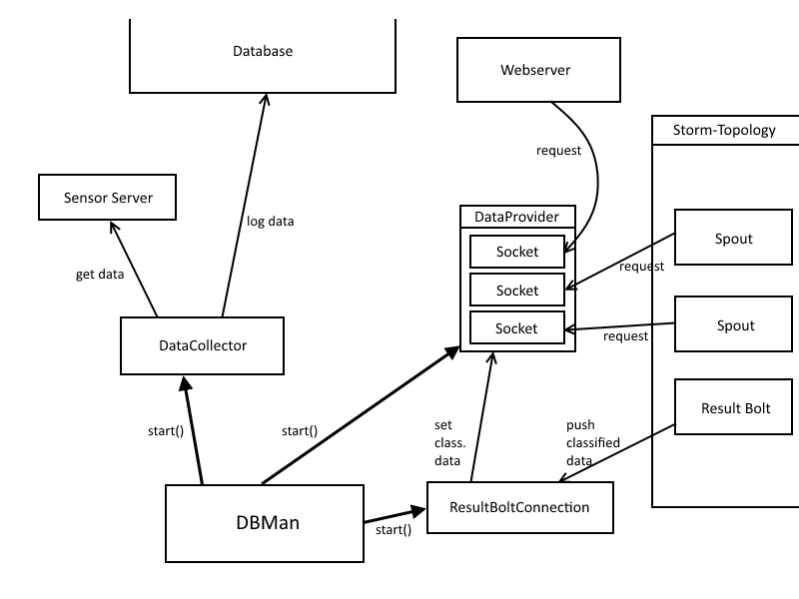
DBMan – After
HS 2015
Current Trends in Distributed Systems – Final presentation

Slide 4
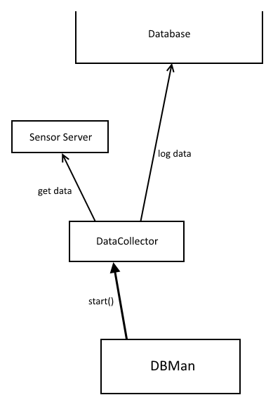
Collecting Data
Central module: DataCollector Thread
Periodically logs data
Independently receives new data
Missing data: default values
HS 2015
Current Trends in Distributed Systems – Final presentation

Slide 5
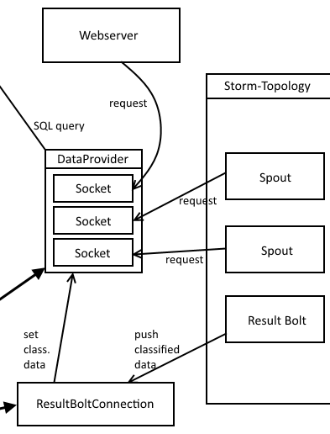
Providing Data
Central Module: DataProvider Thread
  Accepts connections
  Reads data from DB
  Returns JSON
Result Bolt sends classified data tuple
  Can be requested from DataProvider
HS 2015
Current Trends in Distributed Systems – Final presentation

Slide 6
Unnecessary Complexity?
Lots of different modules – why not something easier?
  Resilience: no critical failures, modules easily restarted
  Communication via the internet → unexpected waiting times
    Avoiding blocking methods in important threads
  Reasonable distribution of areas of responsibility
    Easier to trace errors
HS 2015
Current Trends in Distributed Systems – Final presentation

Slide 7
Problems, Challenges and Learned Lessons
OpenWeatherMap
  Overall positive impression
  But not without drawbacks:
    Classification sometimes questionable
    Strange anomalies in provided data
Think BEFORE you code
  Don't just keep fixing the latest error, focus on the big picture
HS 2015
Current Trends in Distributed Systems – Final presentation

Slide 8
HS 2015
Current Trends in Distributed Systems
Final presentation
Group:
Patrick Zumsteg
Simon Wallny
Philipp Oldenburg

